Slide 1

Berkeley Data analysis Final project Machine learning on Housing Price
Team : D
Christie Lafrance, Justin Agogbua, Ran Bi, Shuai Li

Slide 2

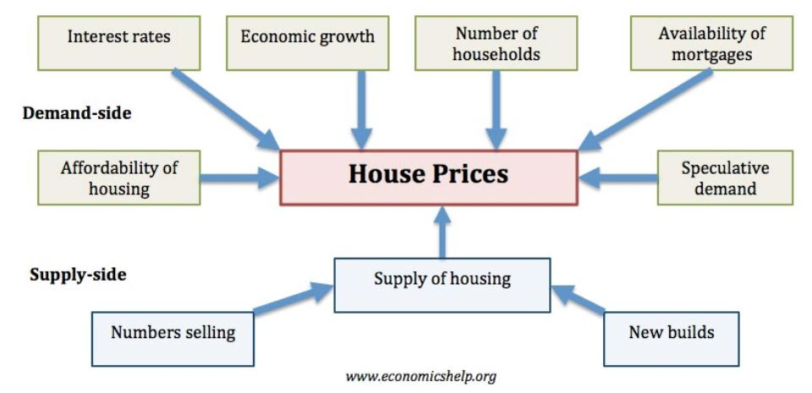
Factors that affect the housing market

Slide 3
Tools we used
Data Source: Census data and population density data in csv format
Tools used:
ML: Sci-Kit Learn
Python:
Pandas/Matplotlib
Flask
JavaScript: Plotly.js
Visualization: HTML/CSS/Bootstrap
Tableau

Slide 4
Data cleaning
After merging datasets, the dataset had 32734 rows
01
Removed all rows containing values such as -666666666.0 or 666668684. The dataset row count dropped to 26531
02
Added calculated columns
03

Slide 5
Correlated FEATURE discovery
Using pandas DataFrame.corr function, performed correlation analysis by plotting the correlation data generated by the function
Dropped feature columns having high correlation ratio (>80%) with other feature columns
The dataset had 18 features prior to correlation analysis. It has 11 features after analysis

Slide 6
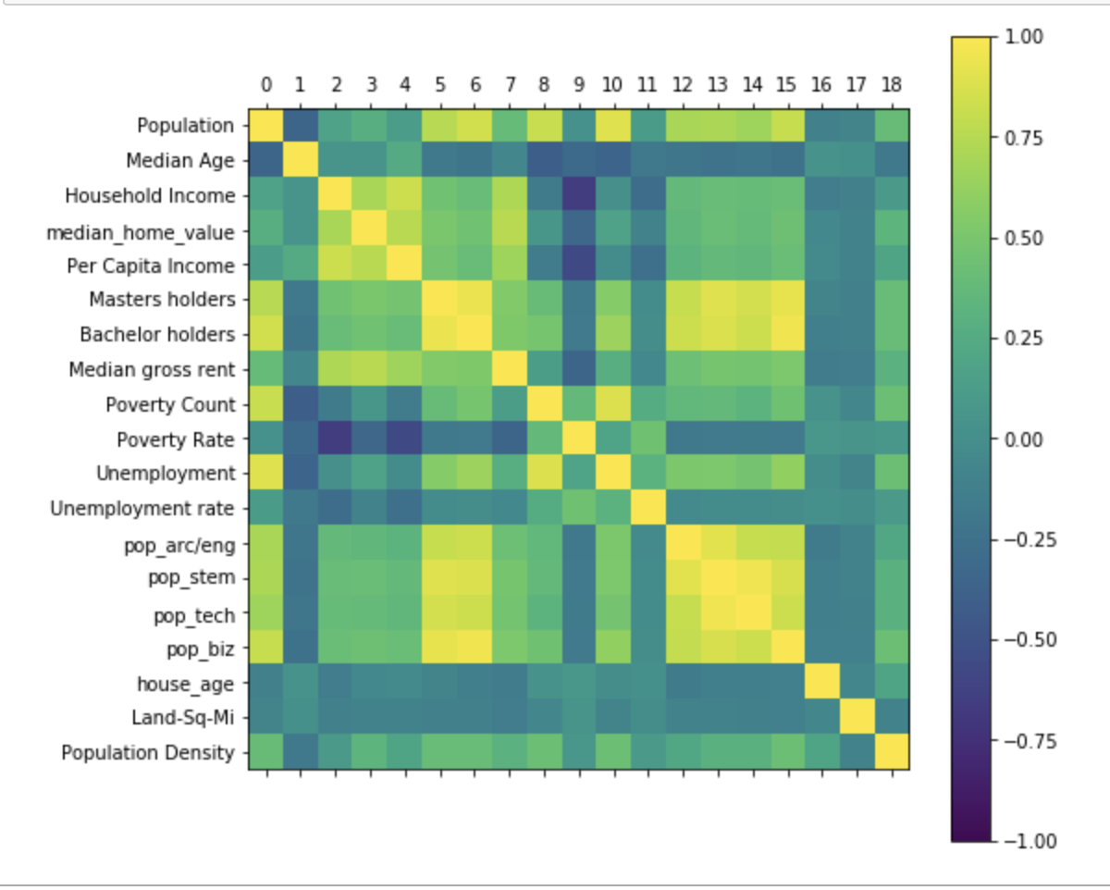
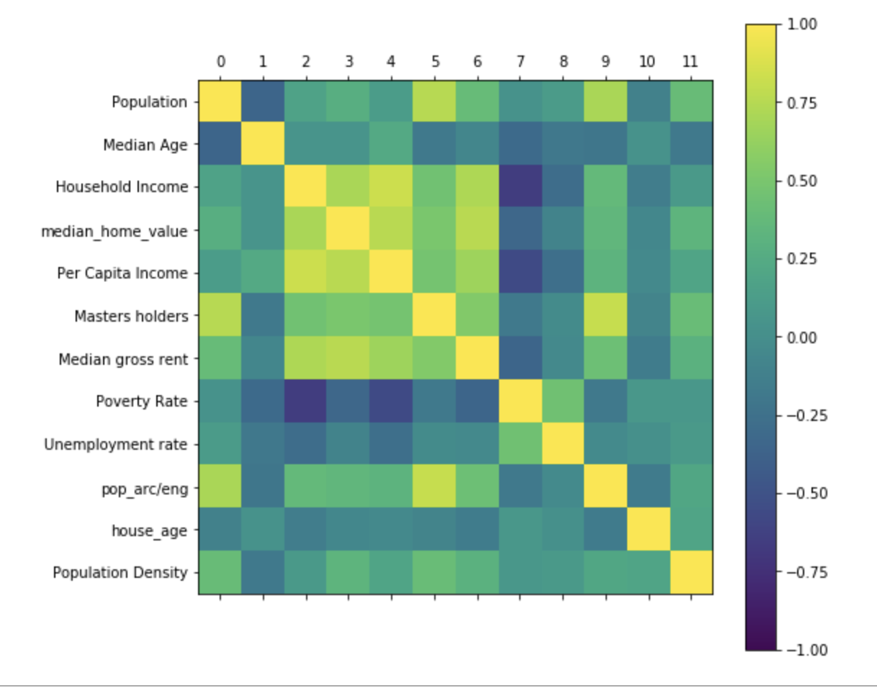
CORRELATION BEFORE AFTER

Slide 7
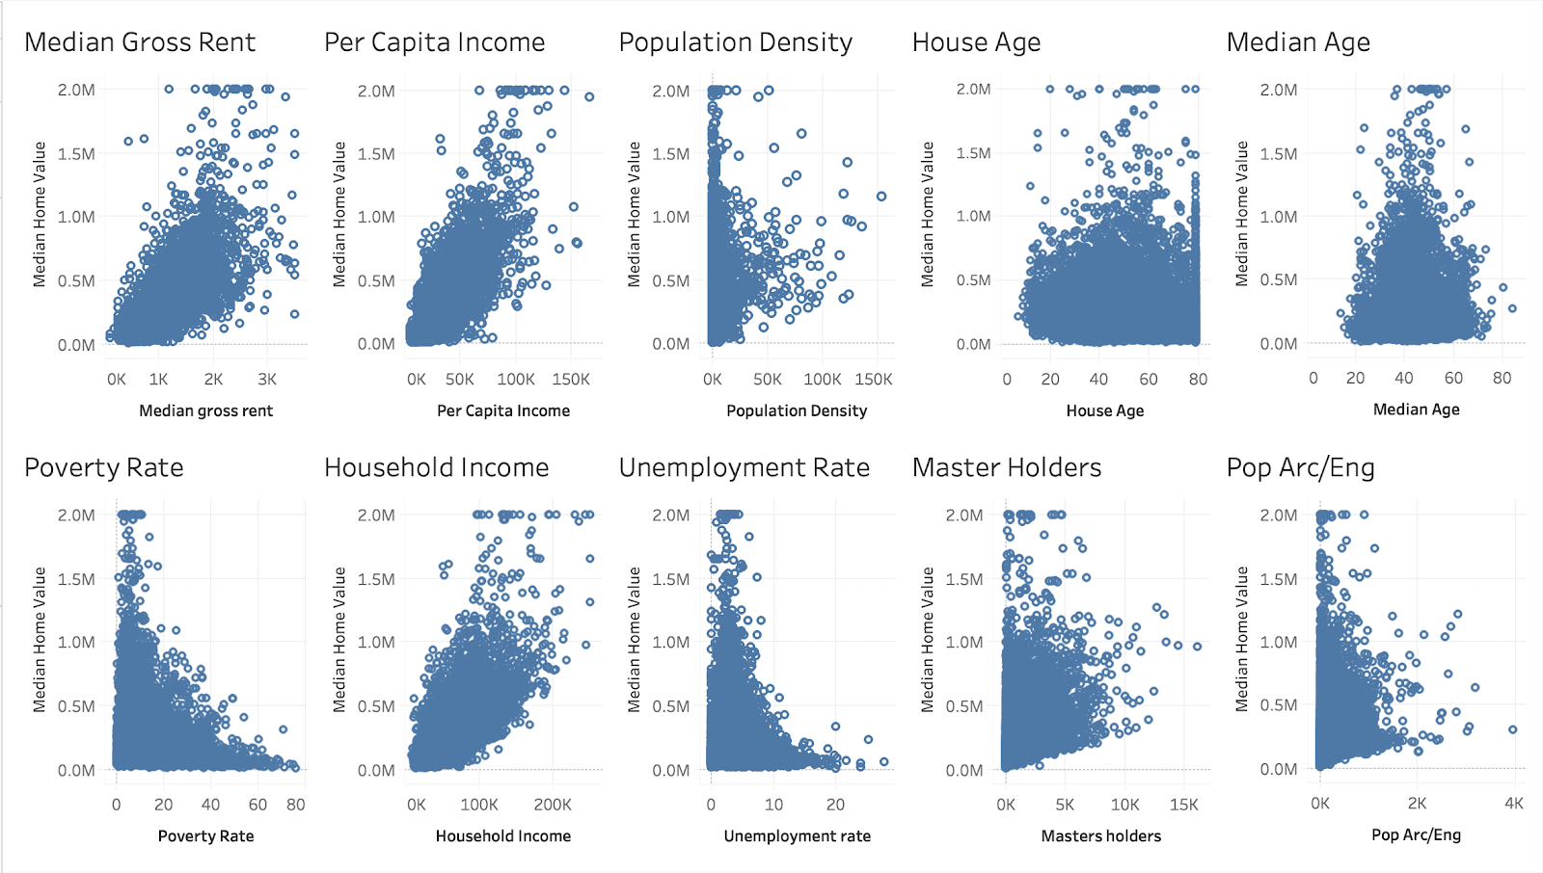
MEDIAN HOME VALUE vs FEATURE PLOTS
These plots helped us see trends and identify extreme data values in the dataset

Slide 8
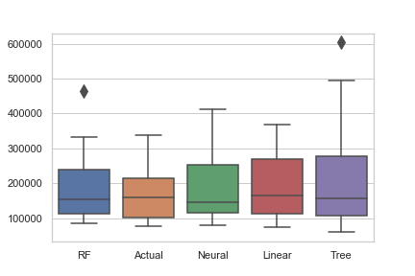
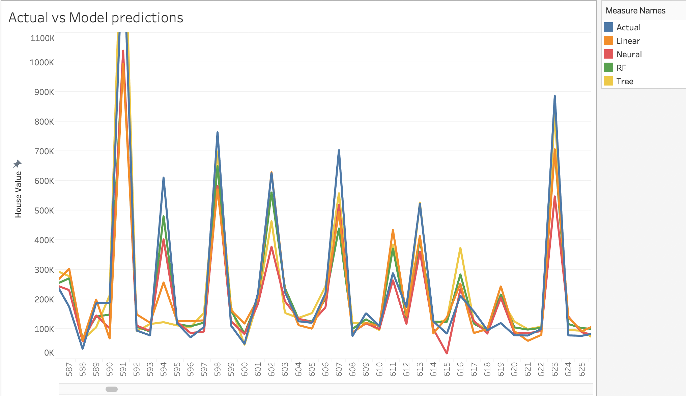
Models we tried
Linear Regression
Random Forest
Decision Tree
Neural Network

Slide 9
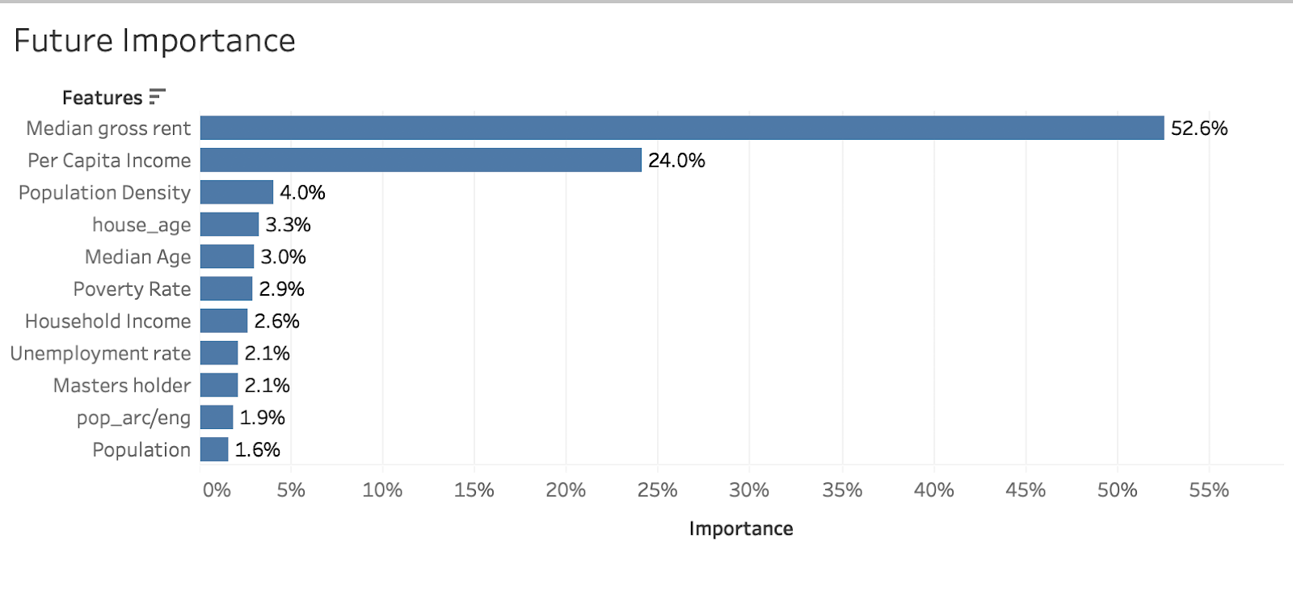
Model Evaluation and Accuracy
Random Forest model gives us highest R2 value
R2 = 0.8157274379688803

Slide 10
Conclusion
Random Forest model gives us highest R2 = 0.816
The weight% of the ML input values have significate affect to the final result
More reasonable data can improve our R2 value

Slide 11
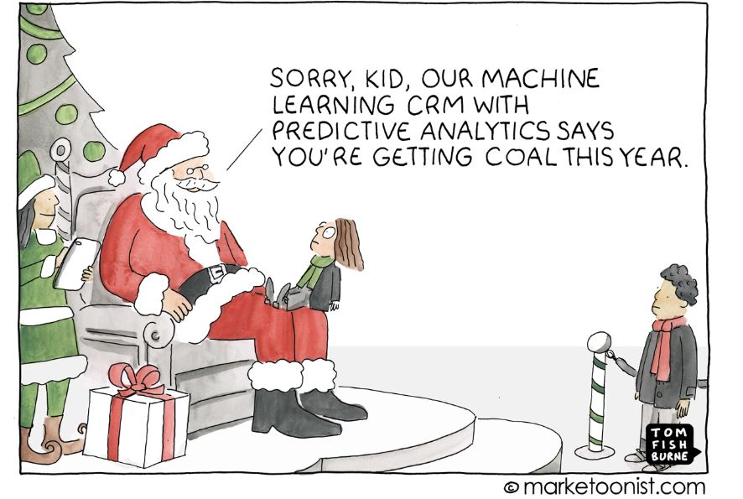
QA?

Slide 12
Thank you !
Instructor: Hamed Nazari
All TAs, especially: Bill Kapaslis, Koren Nishina, Sunny Fung
All Classmates

